Slide 1

6th Grade Math
Unit 1, Lesson 5 Operations with Fractions Volume 1, pg. 26

Slide 2


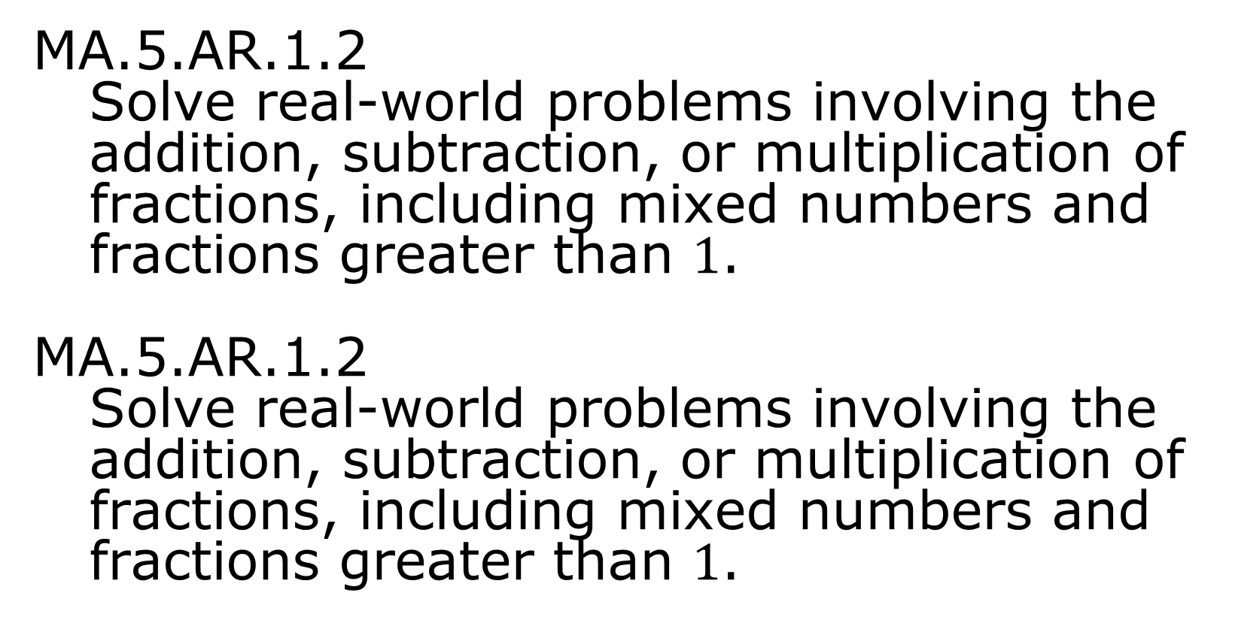
Benchmarks
MA.5.AR.1.2
Solve real-world problems involving the addition, subtraction, or multiplication of fractions, including mixed numbers and fractions greater than $1$.
MA.5.AR.1.2
Solve real-world problems involving the addition, subtraction, or multiplication of fractions, including mixed numbers and fractions greater than $1$.
volume 1, pg. 26

Slide 3
Integrated Mathematical Thinking and Reasoning Standards
MA.K12.MTR.1.1 Actively participate in effortful learning both individually and collectively.
MA.K12.MTR.2.1 Demonstrate understanding by representing problems in multiple ways.
MA.K12.MTR.4.1 Engage in discussions that reflect on the mathematical thinking of self and others.
MA.K12.MTR.5.1 Use patterns and structure to help understand and connect mathematical concepts.
MA.K12.MTR.7.1 Apply mathematics to real-world contexts.
volume 1, pg. 26

Slide 4

Learning Targets
I can solve real-world problems involving adding and subtracting fractions.
I can solve real-world problems involving multiplication of fractions.
I can solve real-word problems involving division of a unit fraction by a whole number.
I can solve real-world problems involving division of a whole number by a unit fraction.
volume 1, pg. 26

Slide 5

Warm-Up
volume 1, pg. 26

Slide 6
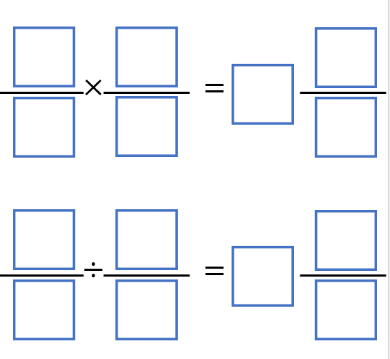
1.5.1 Warm-Up: Critical Thinking
Place a digit in each blue box to make the solutions to the two problems the same. Use only digits 1 to 9, at most one time each.
volume 1, pg. 26

Slide 7

Guided Instruction
volume 1, pg. 27

Slide 8
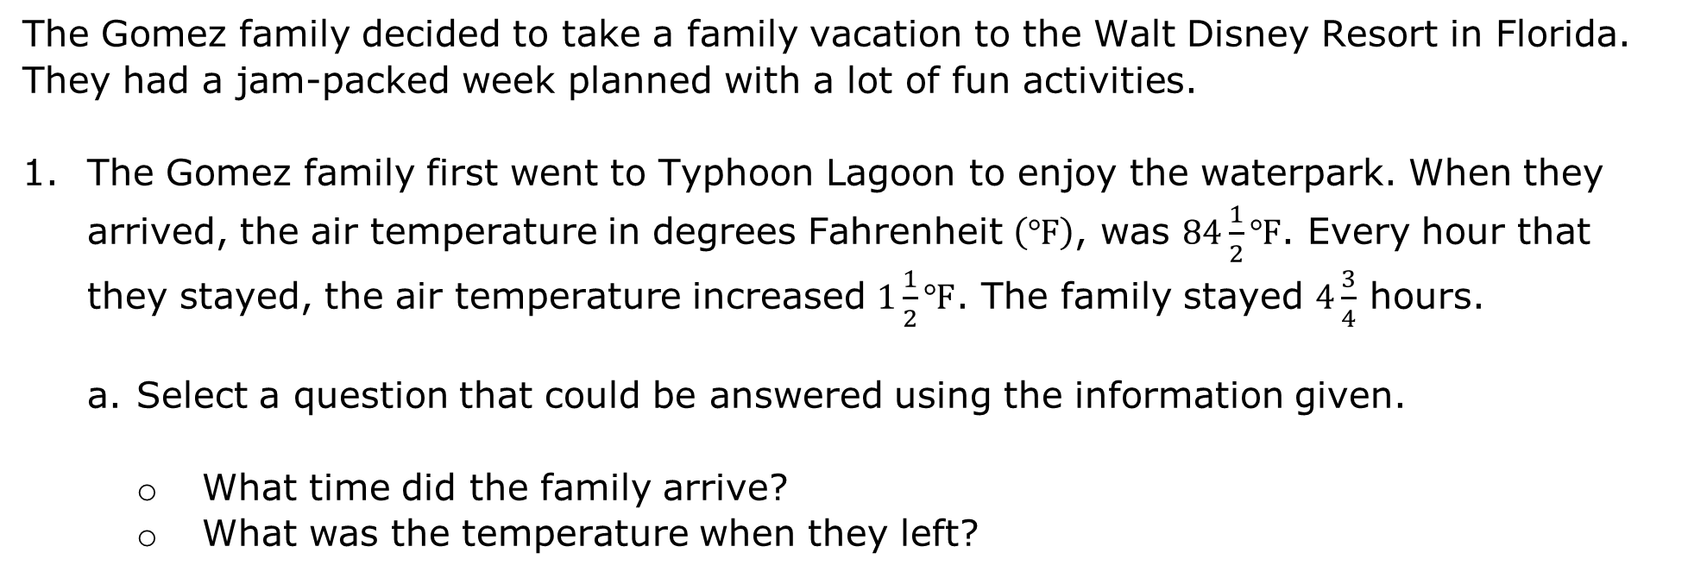
1.5.2 Guided Instruction: Operations with Fractions
The Gomez family decided to take a family vacation to the Walt Disney Resort in Florida. They had a jam-packed week planned with a lot of fun activities.
The Gomez family first went to Typhoon Lagoon to enjoy the waterpark. When they arrived, the air temperature in degrees Fahrenheit $\left(℉\right)$, was $84\frac{1}{2}℉$. Every hour that they stayed, the air temperature increased $1\frac{1}{2}℉$. The family stayed $4\frac{3}{4}$ hours.
Select a question that could be answered using the information given.
What time did the family arrive?
What was the temperature when they left?
volume 1, pg. 27

Slide 9
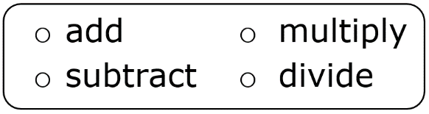
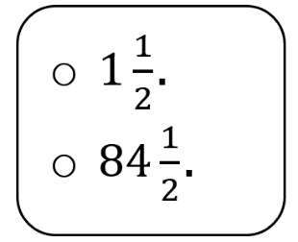
To answer the question, more than one operation will need to be applied. When a word problem uses more than one step it is known as a multi-step problem.
The first step could be to
the number of hours the family spent at the waterpark
by the value
c. Write the expression that represents the first step.
volume 1, pg. 27

Slide 10
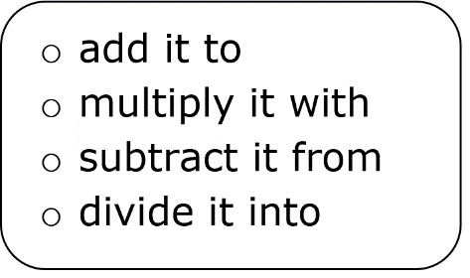
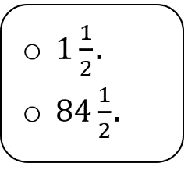
The next step is to use the value that is the
result of the first step and
the value
Write the expression that represents the first step. Then, perform the operation and write the value that is the result of the second step.
Reread the problem. Explain why the result of the second step makes sense for the question you chose.
volume 1, pg. 27

Slide 11
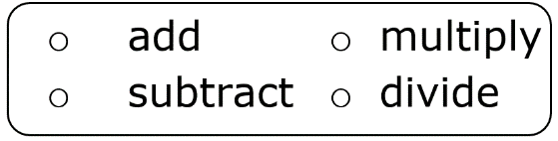
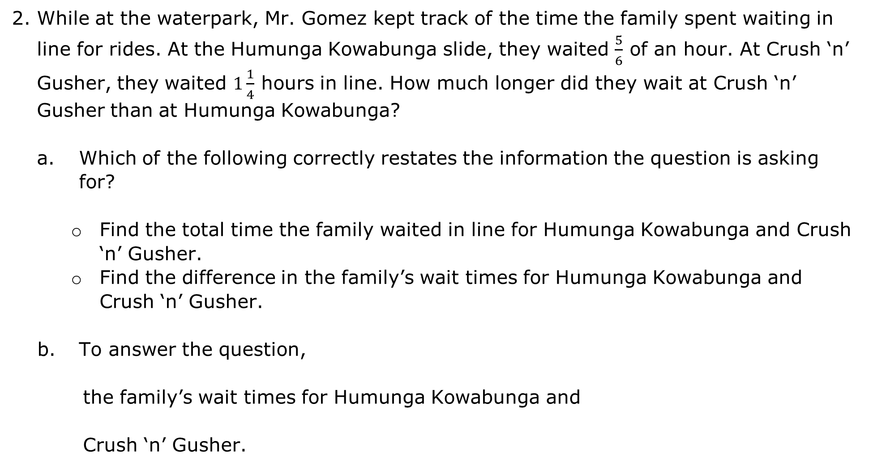
While at the waterpark, Mr. Gomez kept track of the time the family spent waiting in line for rides. At the Humunga Kowabunga slide, they waited $\frac{5}{6}$ of an hour. At Crush ‘n’ Gusher, they waited $1\frac{1}{4}$ hours in line. How much longer did they wait at Crush ‘n’ Gusher than at Humunga Kowabunga?
Which of the following correctly restates the information the question is asking for?
Find the total time the family waited in line for Humunga Kowabunga and Crush ‘n’ Gusher.
Find the difference in the family’s wait times for Humunga Kowabunga and Crush ‘n’ Gusher.
To answer the question,
the family’s wait times for Humunga Kowabunga and
Crush ‘n’ Gusher.
volume 1, pg. 28

Slide 12
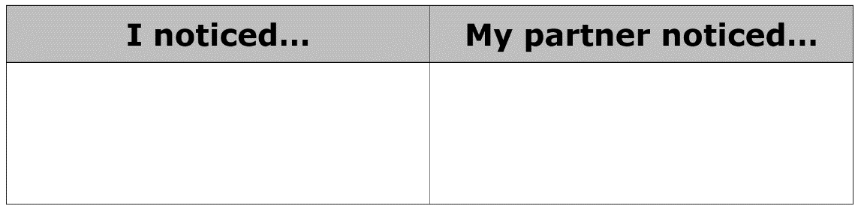
Write the expression that represents the context. Then, perform the operation and write the value that is the result.
Discuss with your partner one thing you noticed between the multi-step problem and the problem that used just one step. Write your observations in the table.
volume 1, pg. 28

Slide 13
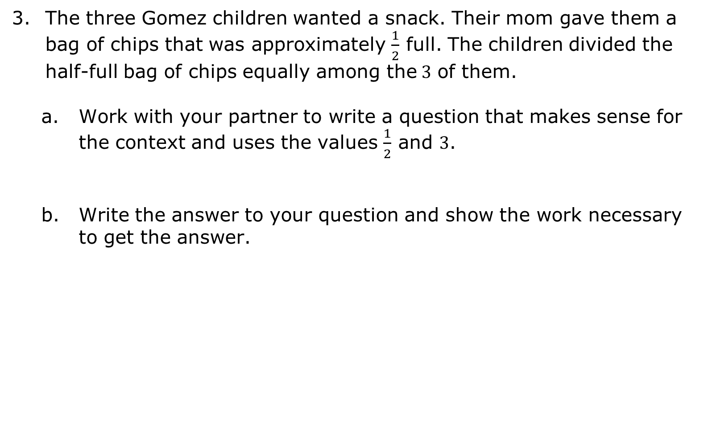
The three Gomez children wanted a snack. Their mom gave them a bag of chips that was approximately $\frac{1}{2}$ full. The children divided the half-full bag of chips equally among the$3$ of them.
Work with your partner to write a question that makes sense for the context and uses the values $\frac{1}{2}$ and $3$.
Write the answer to your question and show the work necessary to get the answer.
volume 1, pg. 28

Slide 14

Guided Practice
volume 1, pg. 29

Slide 15

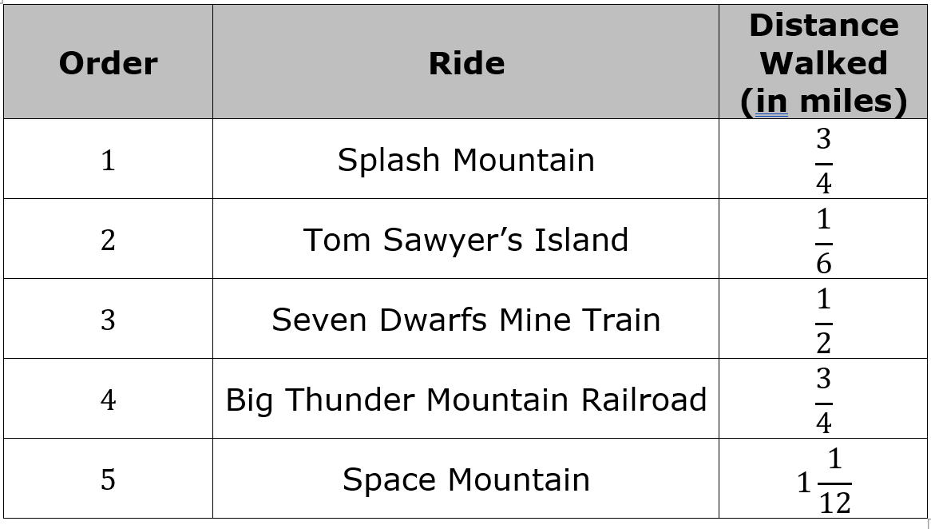
1.5.3 Guided Practice: Operations with Fractions
The Gomez family spent their second day of vacation at the Magic Kingdom. Vario Gomez and his dad left the rest of the family to ride some of the more adventurous rides. A list of the rides in the order they rode them and the distance they walked to get to each ride is shown below.
volume 1, pg. 29

Slide 16
Use the table to answer each of the following questions. Write the expression or equation you use.
Vario tracks his steps using a fitness tracker. He averages 2,000 steps for each mile. How many total steps would Vario and his dad take as they walked to the rides listed in the table?
How much farther, in miles, was the walk to Space Mountain than to Splash Mountain?
volume 1, pg. 29

Slide 17
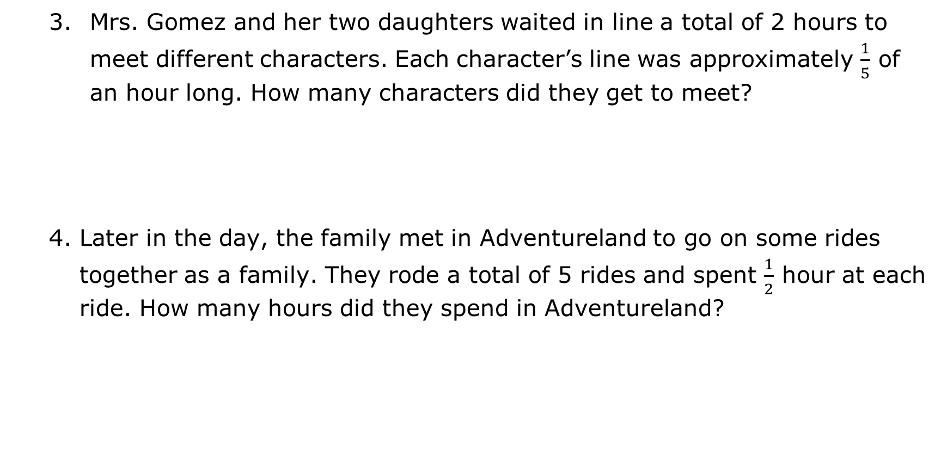
Mrs. Gomez and her two daughters waited in line a total of 2 hours to meet different characters. Each character’s line was approximately $\frac{1}{5}$ of an hour long. How many characters did they get to meet?
Later in the day, the family met in Adventureland to go on some rides together as a family. They rode a total of 5 rides and spent $\frac{1}{2}$ hour at each ride. How many hours did they spend in Adventureland?
volume 1, pg. 29

Slide 18
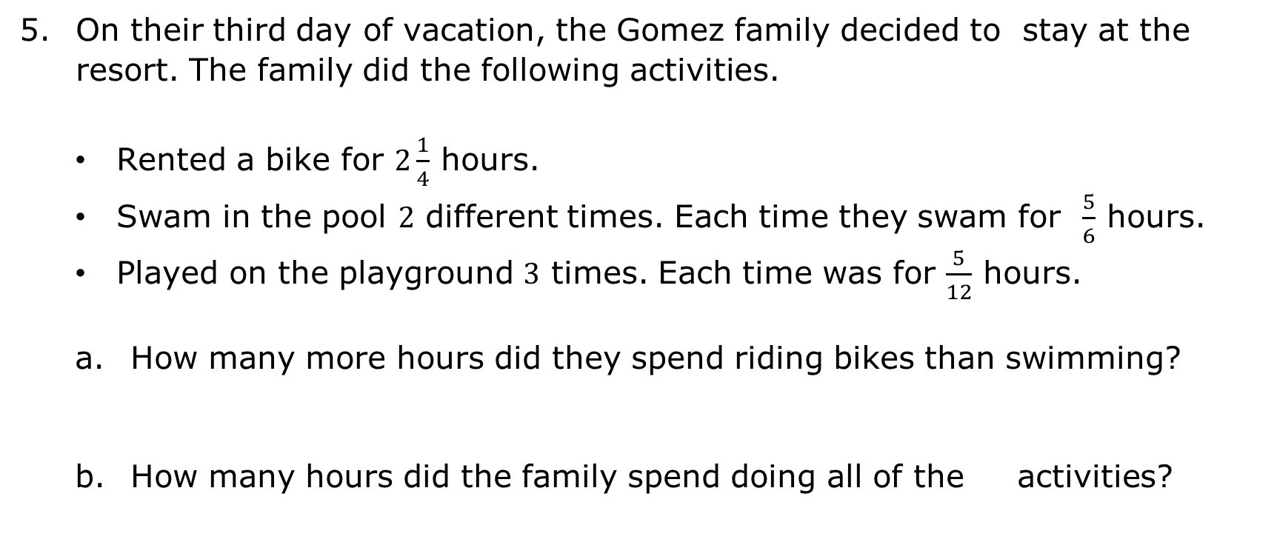
On their third day of vacation, the Gomez family decided to stay at the resort. The family did the following activities.
Rented a bike for $2\frac{1}{4}$ hours.
Swam in the pool $2$ different times. Each time they swam for $\frac{5}{6}$ hours.
Played on the playground $3$ times. Each time was for $\frac{5}{12}$ hours.
How many more hours did they spend riding bikes than swimming?
How many hours did the family spend doing all of the activities?
volume 1, pg. 30

Slide 19

Wrap-Up
volume 1, pg. 30

Slide 20
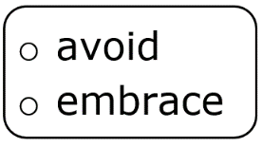
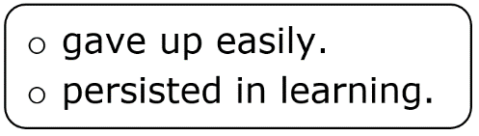
1.5.4 Wrap-Up: Growth Mindset
Today I was challenged by__________________.
When I am challenged I the challenge.
Today, I
Think about the characters in your favorite movie or book. Describe a time the character had to persist in the face of a challenge.
volume 1, pg. 30

Slide 21
Describe something that your teacher can do to help you overcome challenges you may face in math this year.
Describe something that you can do to overcome challenges you may face in math this year.
volume 1, pg. 30

